Slide 1



Smart Crop Recommendation system
A system that recommends the most suitable crops based on soil and environment to optimize yield and promote sustainability.

Slide 2

Learning Objectives
Understand data preprocessing and analysis of agricultural datasets.
Apply machine learning to predict suitable crops from soil and climate data.
Perform EDA and visualize key insights for decision-making.
Deploy ML models to provide accessible, actionable recommendations.
GOAL

Slide 3
Tools and Technology used
Programming Languages: Python
Libraries: Pandas, NumPy, Scikit-learn, Matplotlib, Seaborn
Deployment: Jupyter Notebook, Streamlit/Flask (for web app deployment)
Data Sources: Soil data, weather datasets, crop yield records\
GitHub for version control & project documentation
Flask or Google Colab deployment for interactive prediction

Slide 4
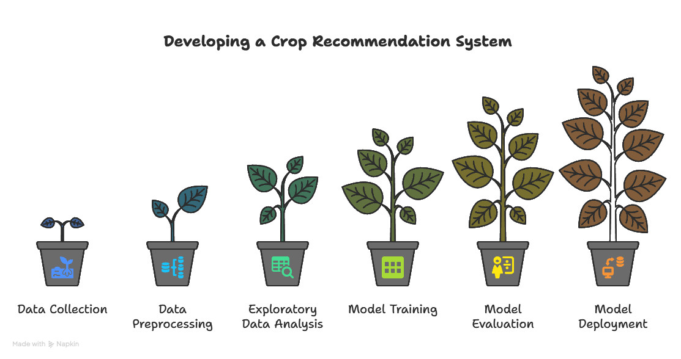
Methodology

Slide 5
Methodology
Data Collection: Gather soil, weather, and crop yield datasets.
Data Preprocessing: Handle missing values, normalize features, encode categorical data.
Exploratory Data Analysis (EDA): Identify key factors influencing crop yield.
Model Training: Use classification algorithms (e.g., Random Forest, Decision Tree) to predict suitable crops.
Model Evaluation: Test accuracy using metrics like accuracy score and confusion matrix.
Deployment: Create a simple web app for user input and crop recommendation.

Slide 6
Problem Statement:
Farmers often struggle with selecting the right crop due to varying soil nutrients, pH levels, and unpredictable climate conditions. Lack of scientific decision-making leads to reduced yield, soil degradation, and unsustainable farming practices.

Slide 7
Solution:
Develop an AI-powered Crop Recommendation System that predicts the most suitable crop based on soil nutrients (N, P, K), temperature, humidity, pH, and rainfall.
Helps farmers make data-driven crop decisions.
Supports sustainability by recommending crops aligned with environmental conditions.
Can be deployed as a web tool or mobile app for real-world accessibility.
Github repository link: https://github.com/prathikshaarul/Shell-internship

Slide 8
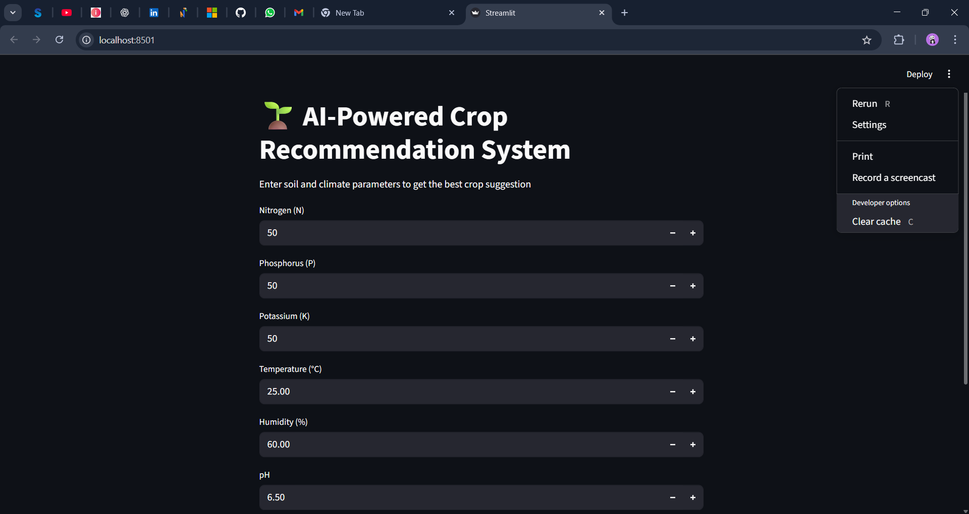
Screenshot of Output:

Slide 9
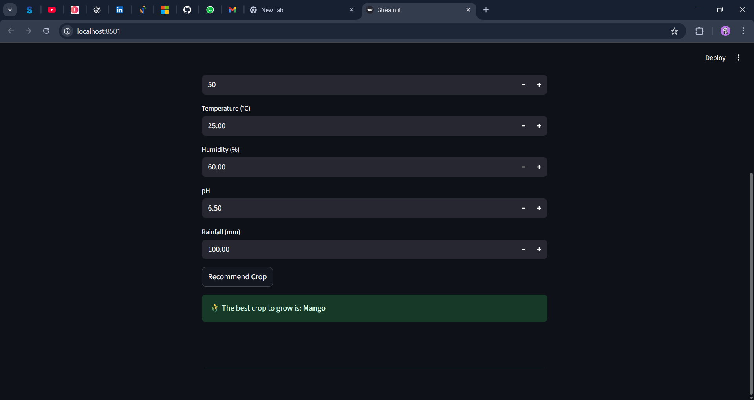
Screenshot of Output:

Slide 10
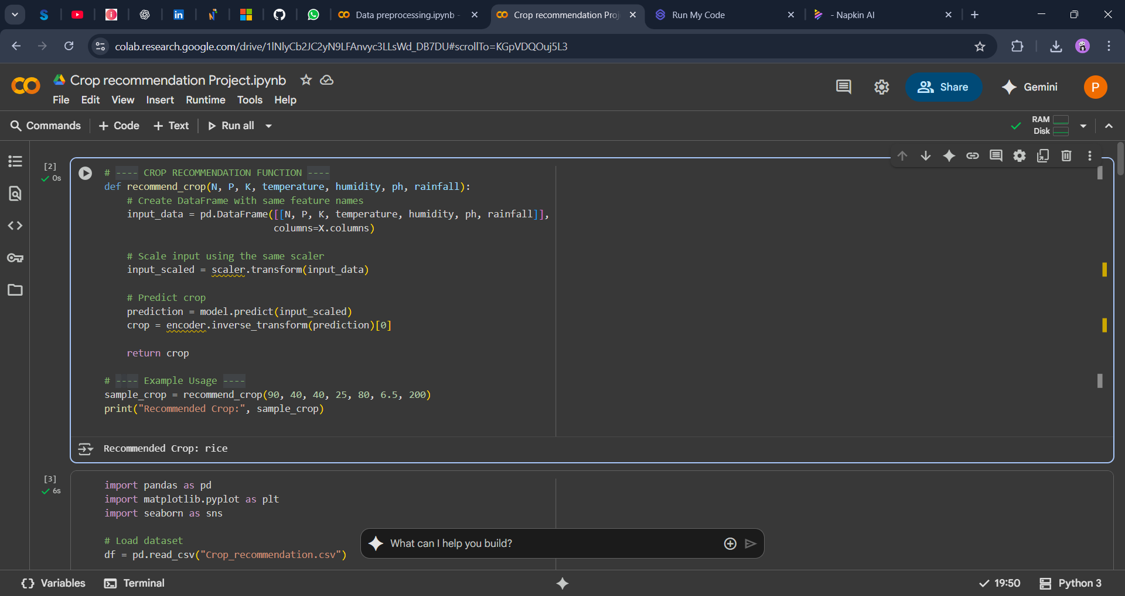
Screenshot of Output:

Slide 11
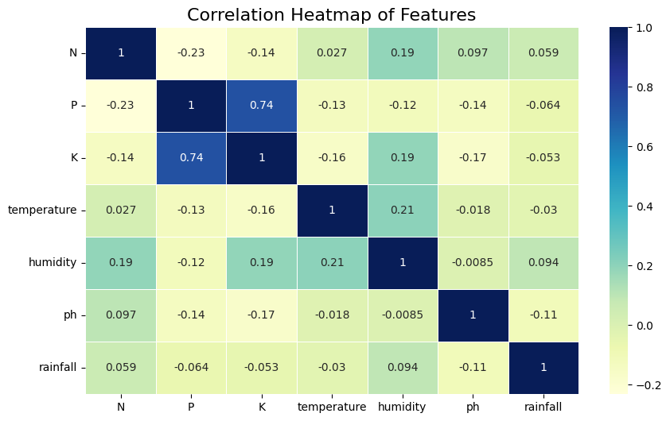
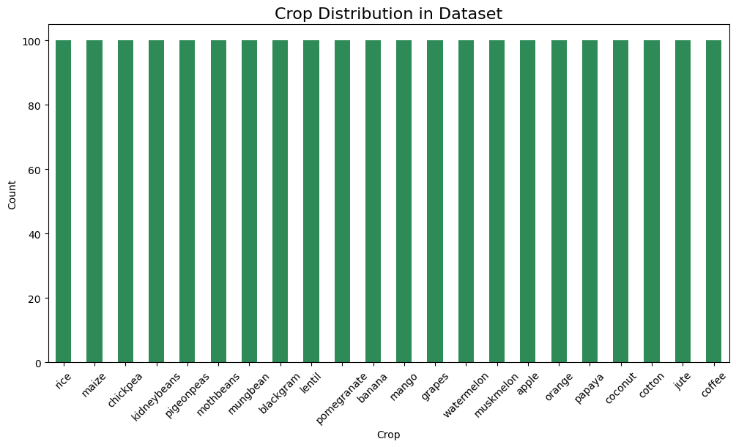
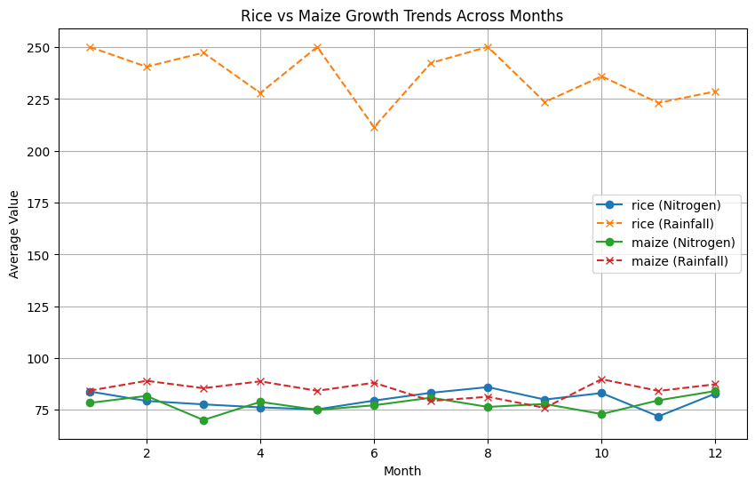
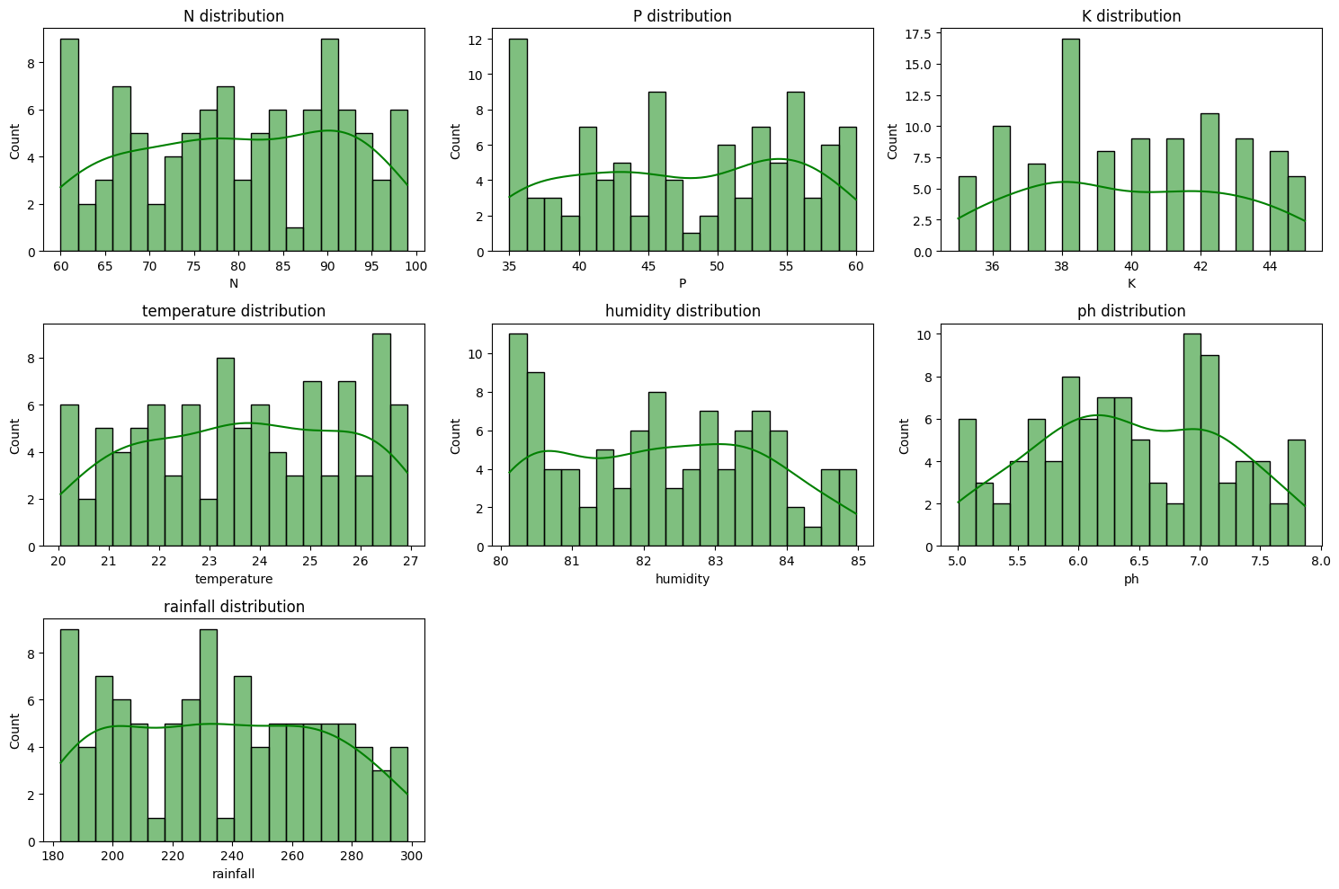
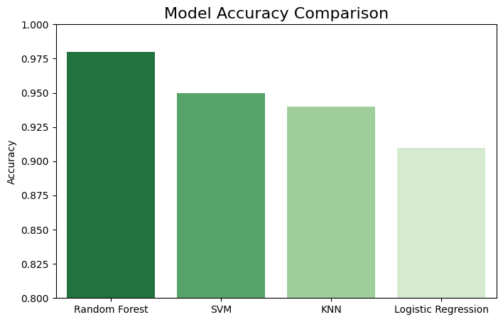
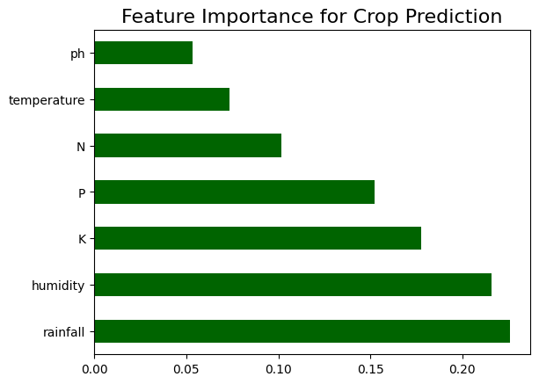
Screenshot of Output:

Slide 12
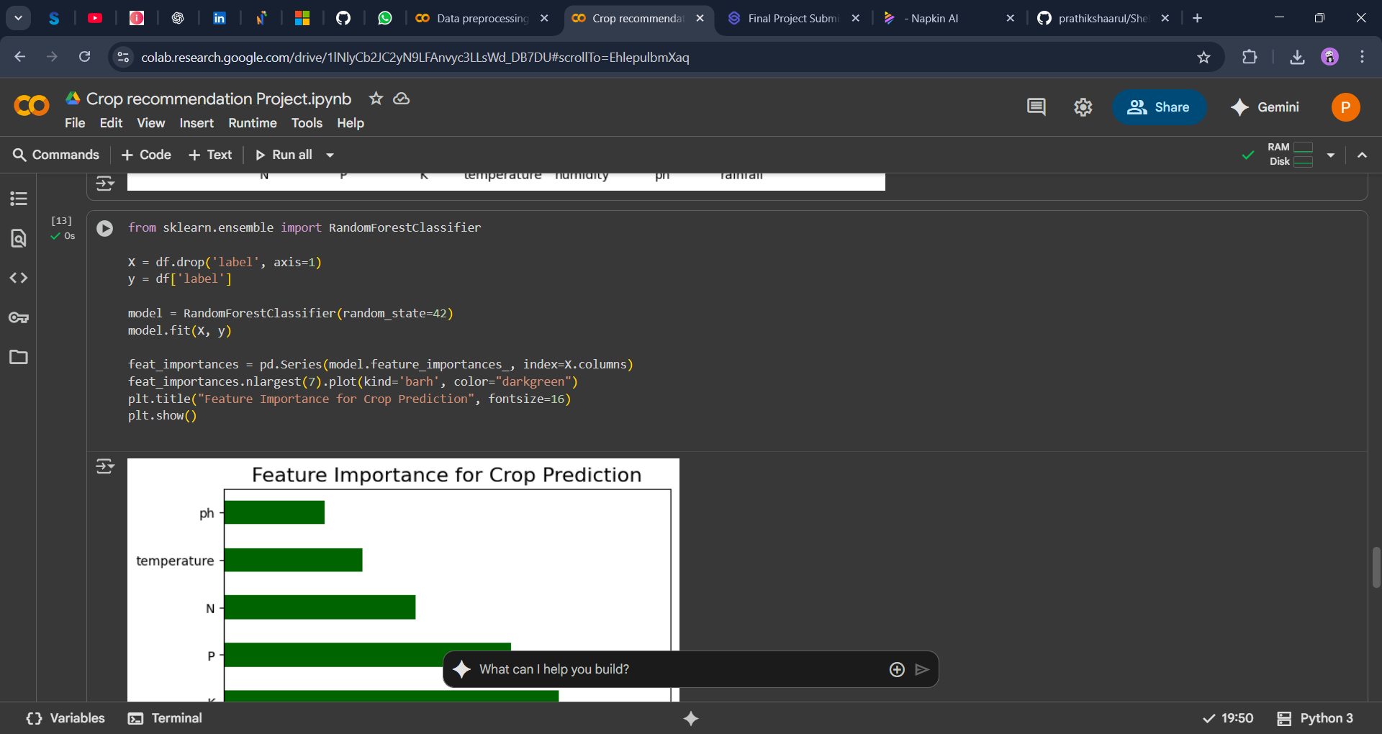
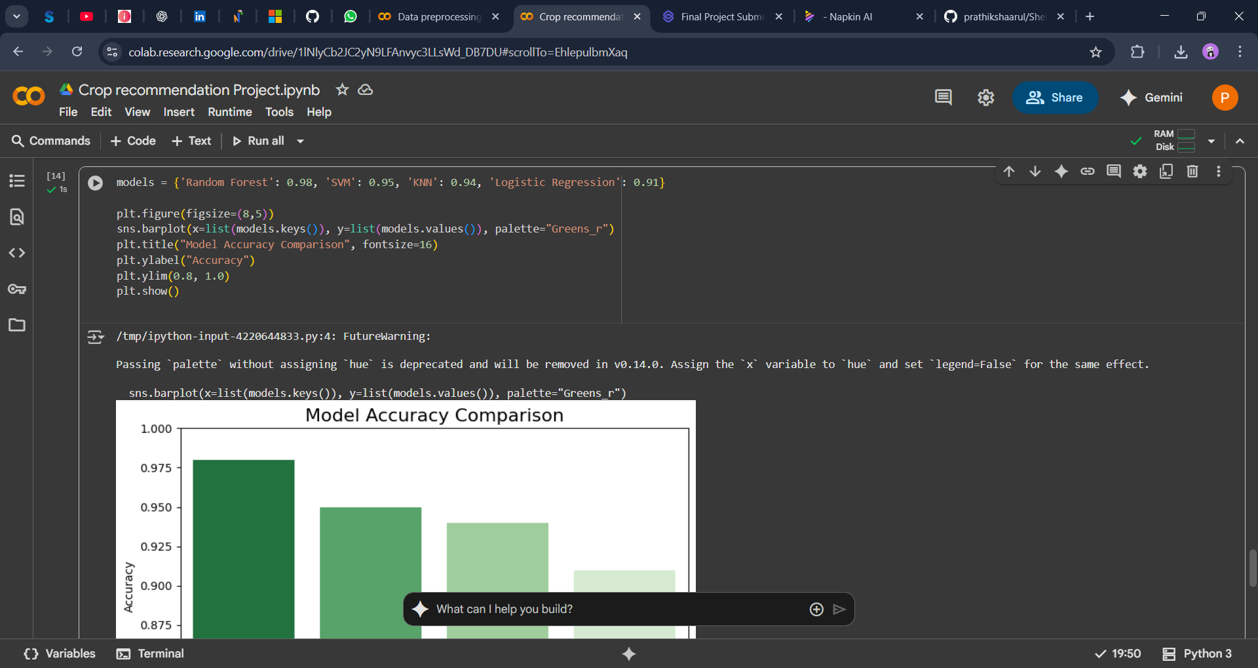
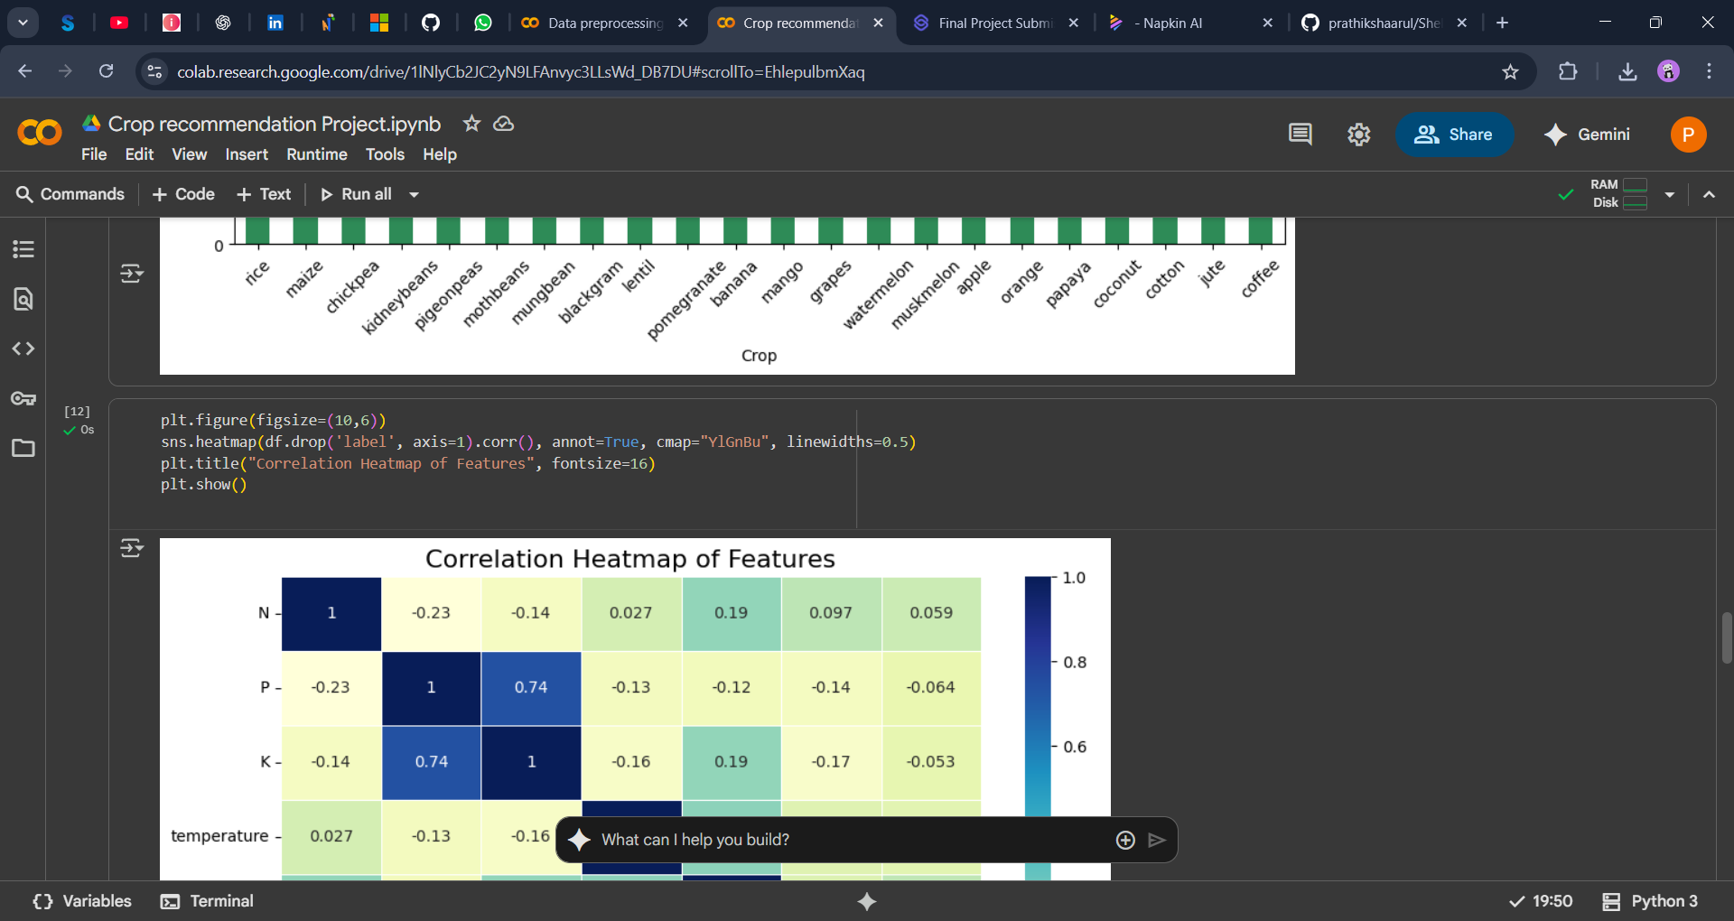
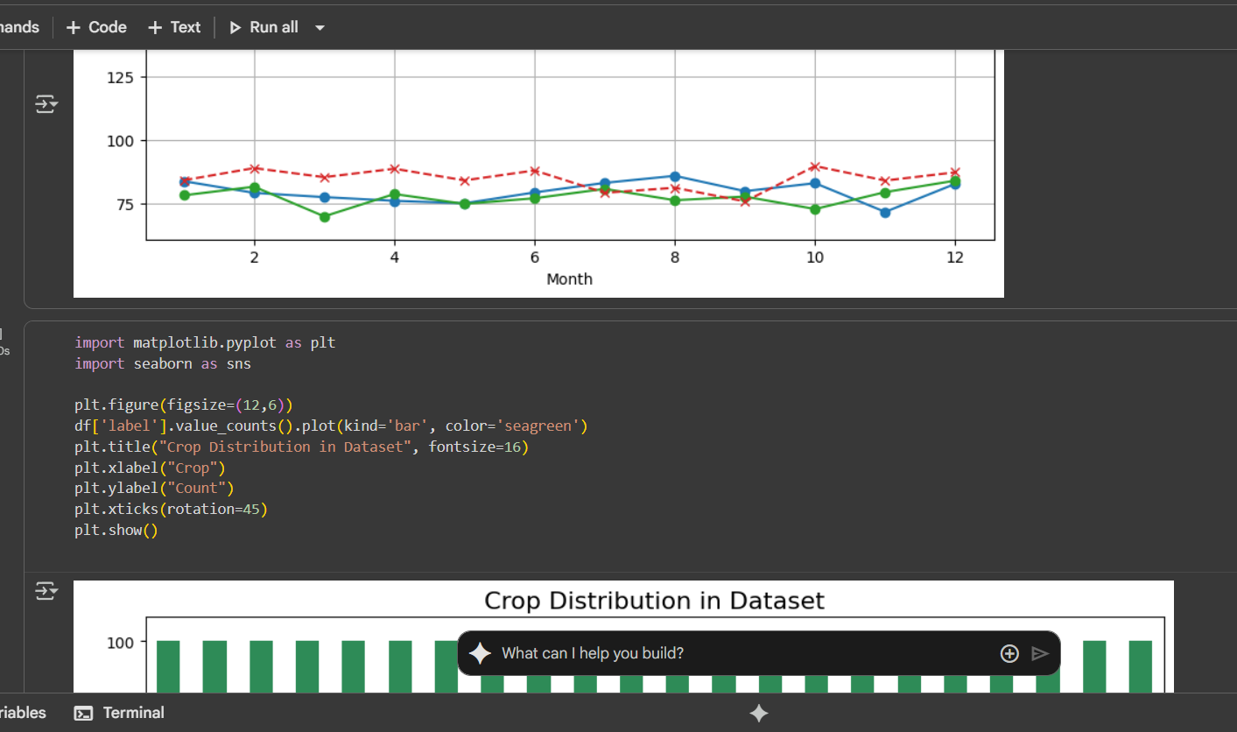
Screenshot of Output:

Slide 13
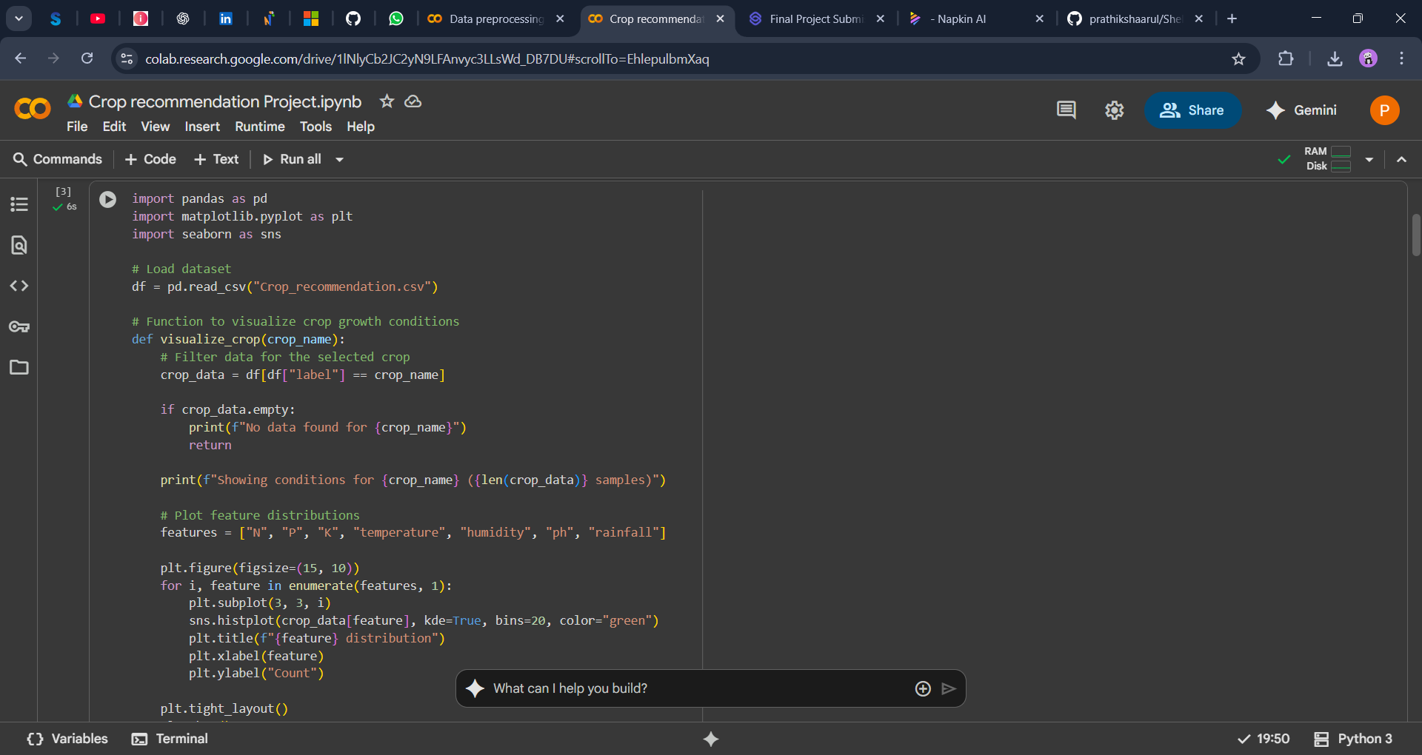
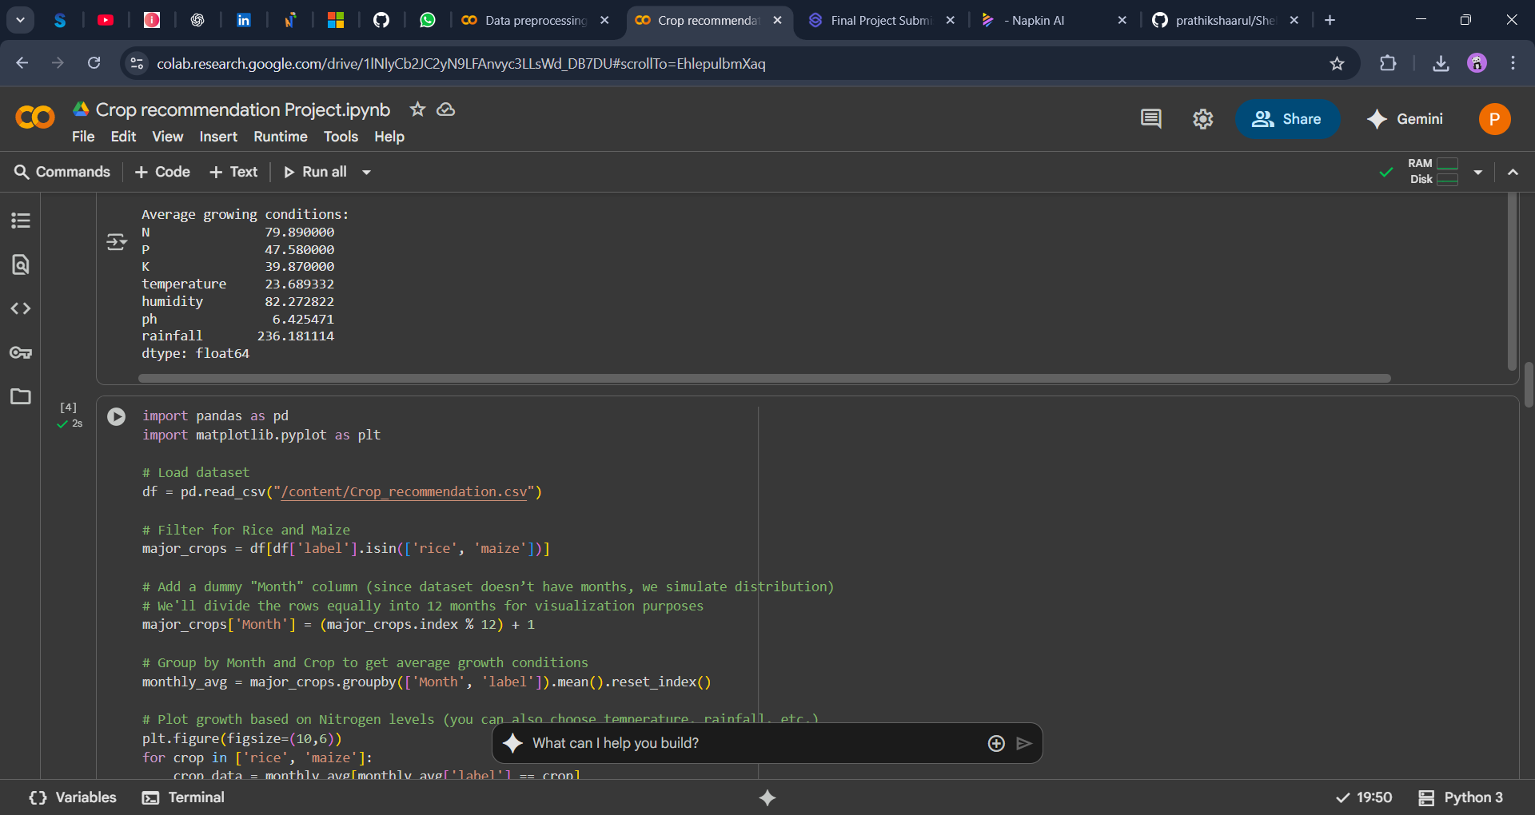
Screenshot of Output:

Slide 14
Conclusion:
This project combines data science, machine learning, and deployment skills to solve a real-world agricultural challenge. It not only improves crop yield and farmer income but also promotes sustainable agriculture, aligning with global goals of food security and environmental conservation.
Enables data-driven decision-making for farmers, reducing trial-and-error crop selection.
Provides a scalable solution that can be extended to different regions and crop types.
Encourages the use of modern technology in traditional farming practices.
Demonstrates the practical application of ML models from data preprocessing to deployment.
Can be further enhanced with real-time weather updates, IoT-based soil sensors, and mobile accessibility for wider reach.

Slide 15
THANK YOU
Project submission by: Prathiksha Arutchezhian
AICTE Student ID: STU6862db624b33f1751309154
AICTE Internship ID: INTERNSHIP_17513641056863b20937d78

